Slide 1
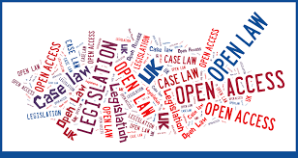
Law & Legislation level 3 Close Protection Operations
Working as a Close Protection Operative
Understand the legislation that is relevant to people working in the close
Protection Industry.

Slide 2
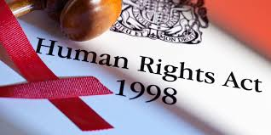
Law & Legislation level 3 Close Protection Operations
Identify the main functions of the Security Industry Authority and other key bodies within the private security industry.
Identify aspects of human rights legislation that are relevant to the private security industry.

Slide 3


Slide 4
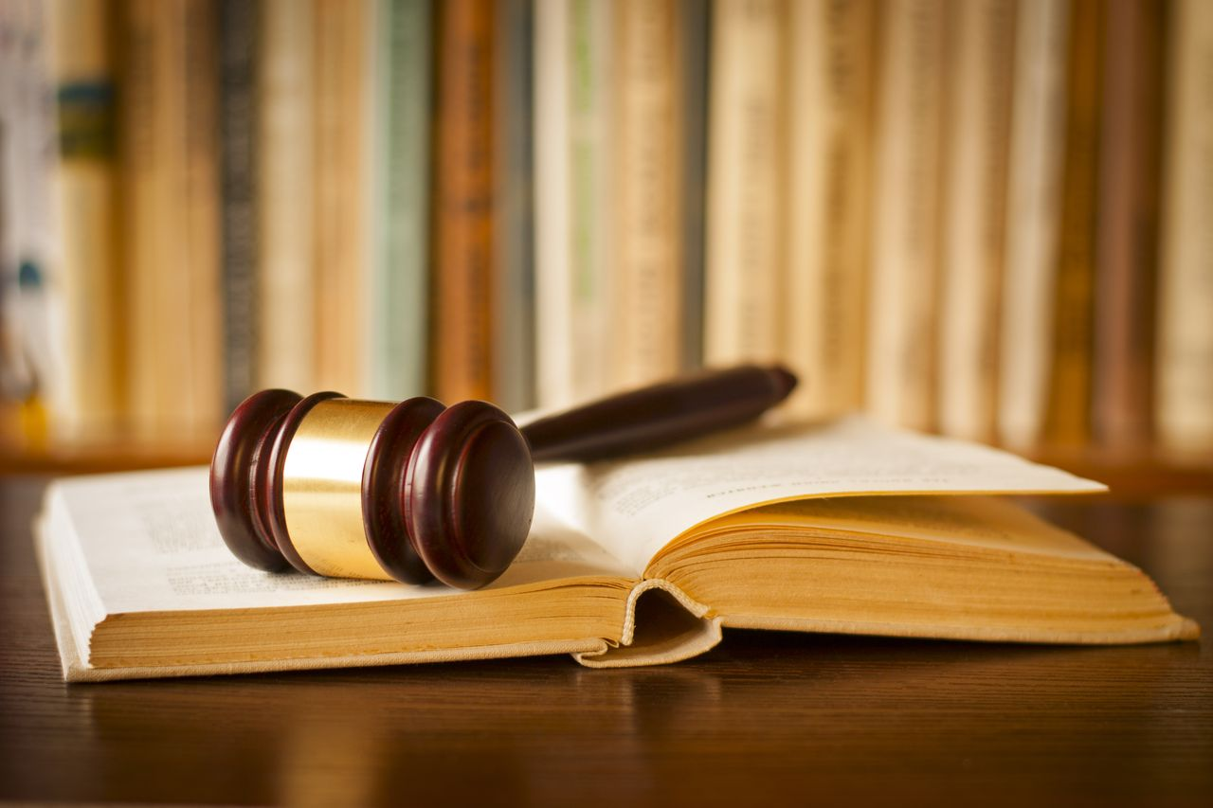
Law & Legislation level 3 Close Protection Operations
The 3 types of Law
Civil Law
Criminal Law
Common Law
Notes:
Civil law
magistrates/county court
criminal: judge, jury, crown court
common law: custom and practice, statute law, acts of parliament

Slide 5
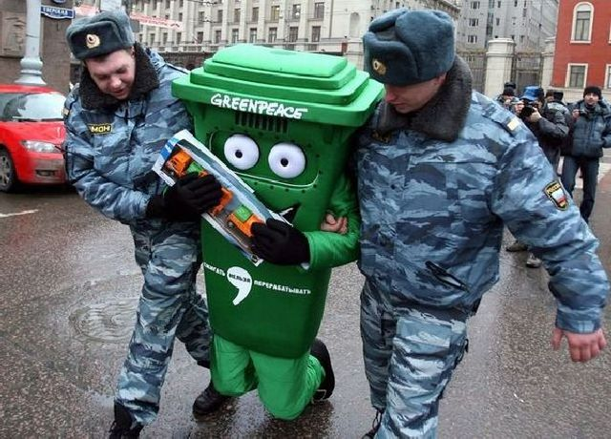
Law & Legislation level 3 Close Protection Operations
Arrest
What is an arrest?
The term arrest means Take away or deprive a person of their liberty

Slide 6
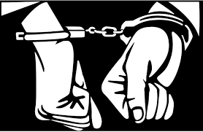
Law & Legislation level 3 Close Protection Operations
Arrest Procedures
When an arrest is made the following must be explained to the suspect.
Who you are.
That you are arresting them.
The reason the person is being arrested.

Slide 7

Legislation
SURVEILLANCE
Regulation of Investigatory Powers Act 2000 (RIPA 2000) – Watching or listening. There are no controls over what we see or hear. So long as we have no enhancements we commit no offences.

